Slide 1

C++ string project
Prepared by: Stanislav Todorov, Todor Bojinov, Borislav Ferdinandov, Petar Petkov.

Slide 2
Content
Our team
Future plans
Idea of the project
Where and for what we used the technologies

Slide 3
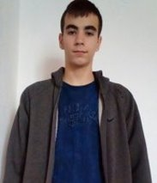
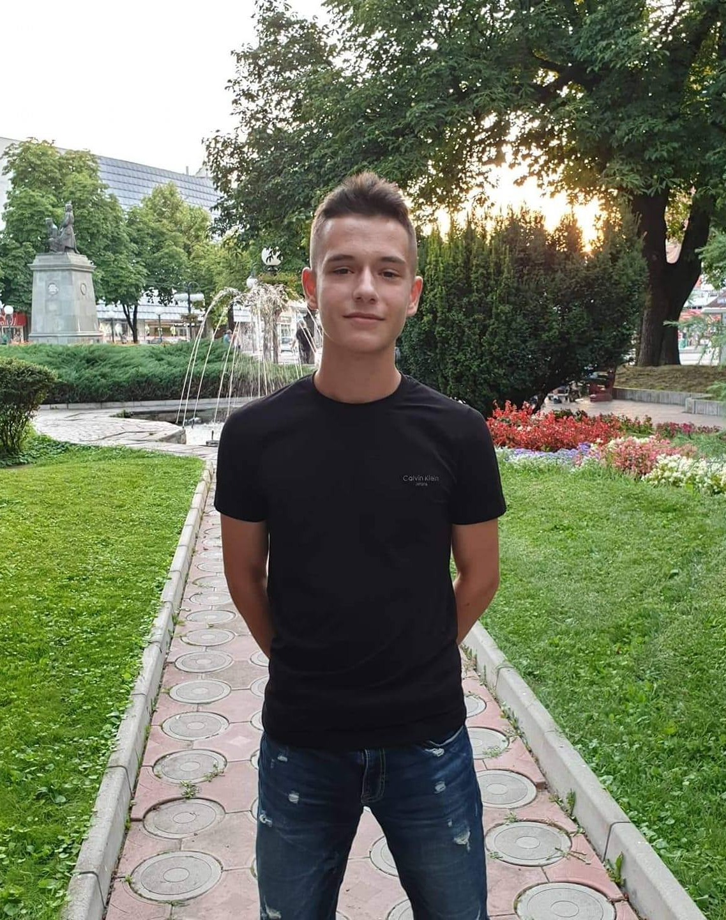
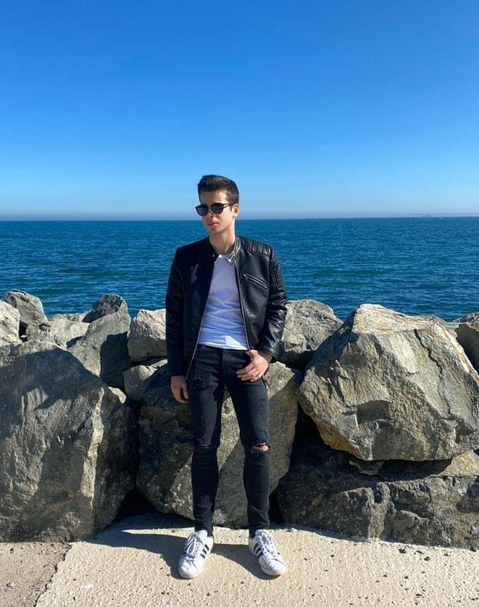
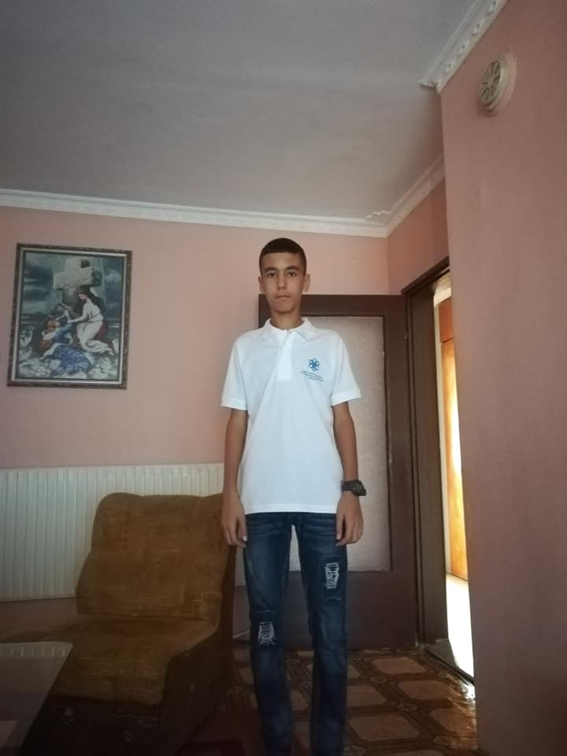
Our team

Slide 4

Idea of the project
The idea of our project, was to make a game that people could have fun with and test their knowledge.

Slide 5



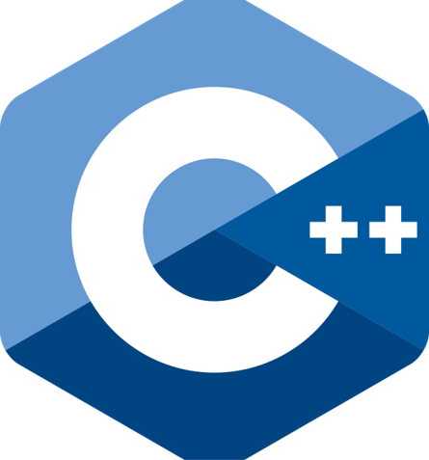



What technologies we used and for what:
The code was written in C++, programming environments were repl.it and Visual Studio, GitHub to upload the code, Microsoft Teams to communicate, Microsoft Word for writing the documentation and Microsoft Power Point for this presentation.

Slide 6

Future plans
To improve the functionality of the program
Make the different versions of Who Wants to Be a Millionaire? In the different countries
To promote it

Slide 7


